Slide 1
DBS Communities
DBS Affordable Home Strategy Ltd.
Ahmedabad, India
DBS Communities Presentation For
Mahindra Lifespace
&
Ms. Anita Arjundas
Monday, 18th July 2016

Slide 2
Who Are We & What We Do
DBS Communities is the flagship enterprise of DBS Affordable Home Strategy Limited and other closely held group companies
Established in 2009 to Create Viable Enterprise Models for making Affordable Housing available to low-income families in urban India
DBS Communities has been exclusively focusing on
“Social Affordable Housing” since its inception
Having SAATH & Mahila Housing Sewa Trust as credible NGO Partners to act as an interface for customers and for creating inclusive communities inside our projects
DBS Communities Team consists of Dedicated Professionals from the Real Estate Industry

Slide 3
How We Do - Our Unique Approach - Our Enterprise Model
The Enterprise Model and Business Strategy of DBS Communities is built on three core areas :
Design and Production of Houses
Design and Production of Social Community Housing
  Designing and Producing Social Housing Units which are “Right Sized and Right Priced”
Housing Finance Access
  Facilitating Housing Finance for low income households who do not have formal access to Housing Finance due to lack of adequate documents
Community Development
  Actively support the upward mobility of customers by Creating Communities and enabling activities for improving their credit worthiness
Housing Finance
Community Development Initiatives
RESEARCH & DEVELOPMENT

Slide 4

Our Target Segment & Products Since Inception
Our Target Customer Segment:
Families with incomes ranging upto 30,000/- Rupees
Our Products:
Residential Apartments priced between Rs. 6 lakhs to 15 lakhs
Consisting Primarily of 1 Room-Kitchen Apartments (16.4-18.77 sq. meter Carpet Area) and
2 Room-Kitchen Apartments (25.36-32.14 sq. meter Carpet Area)
For the economic viability of projects,
we also have a small percentage of 3 Room-Kitchen Apartments (42.64-52.67 sq. meter Carpet Area)
priced from Rs. 10.46 Lakhs to Rs. 17.32 Lakhs
‘Umang’ means JOY

Slide 5
Our Achievements & Future
Incorporated in 2009…
Pilot Project Construction Started in End of 2010…
In 5 Years…
8 Projects…
Presence in Ahmedabad & Surat cities…
5872 Social Affordable Housing Units Launched…
3565 Units Already Delivered…
2307 Units Under Construction
10,000 more Units Planned & In Pipeline…

Slide 6
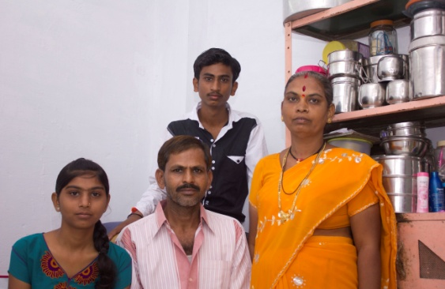
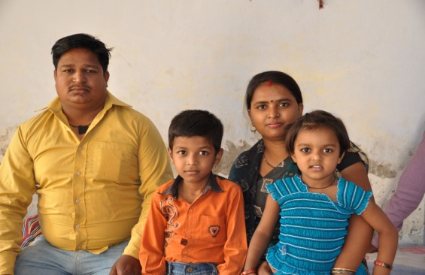
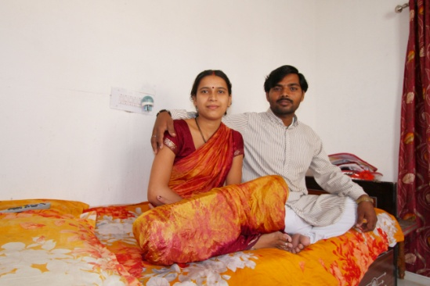
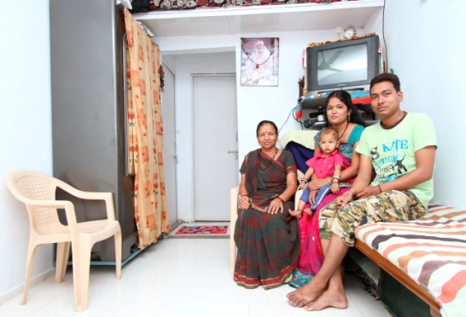
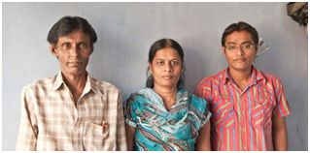
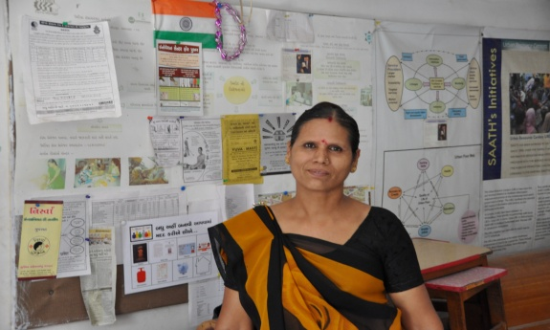
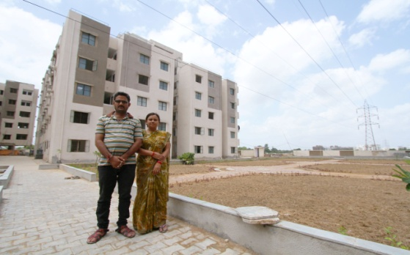
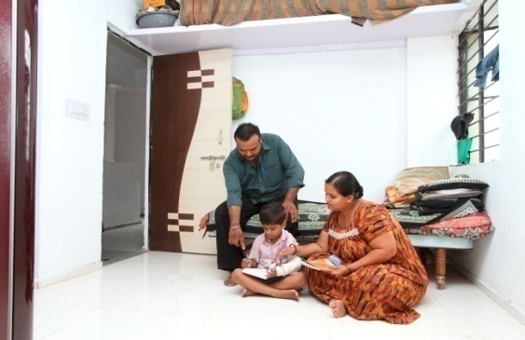
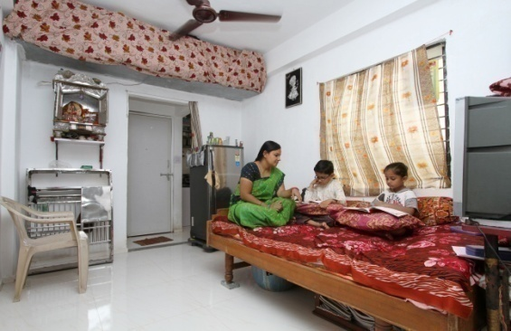
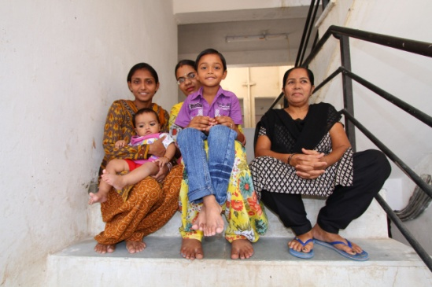
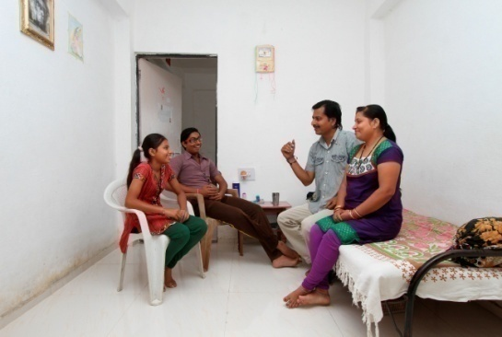
Some of Our Customers

Slide 7
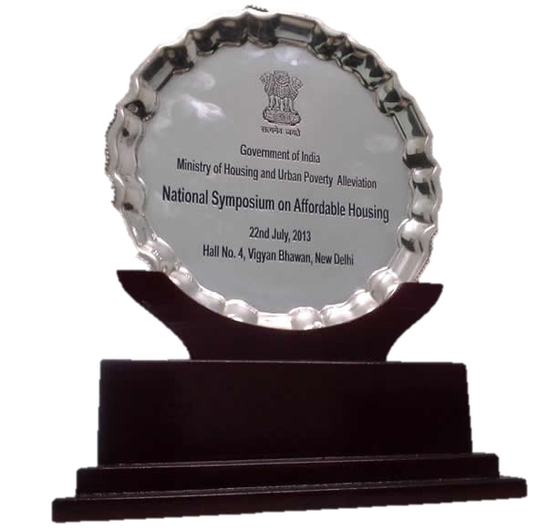
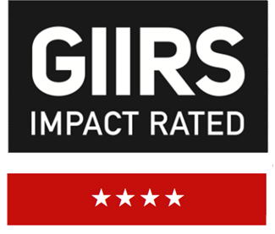
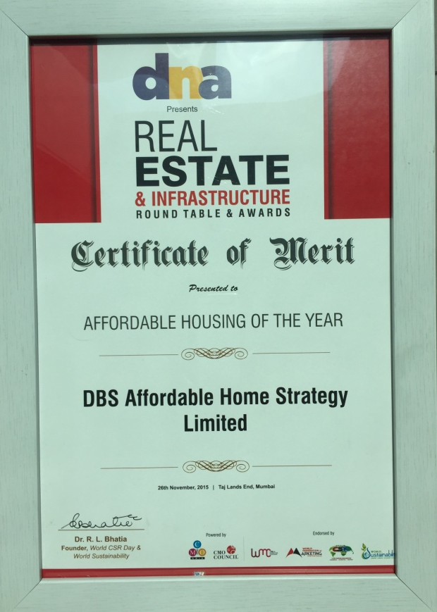
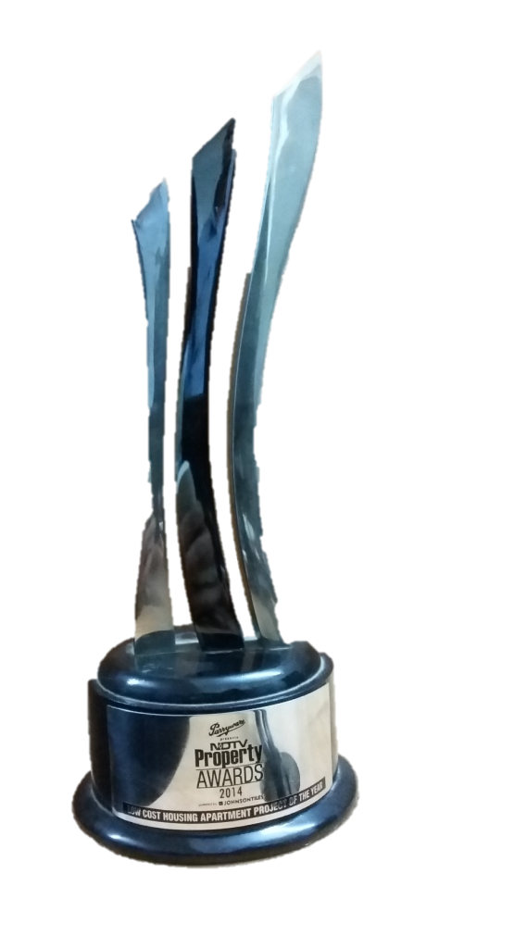
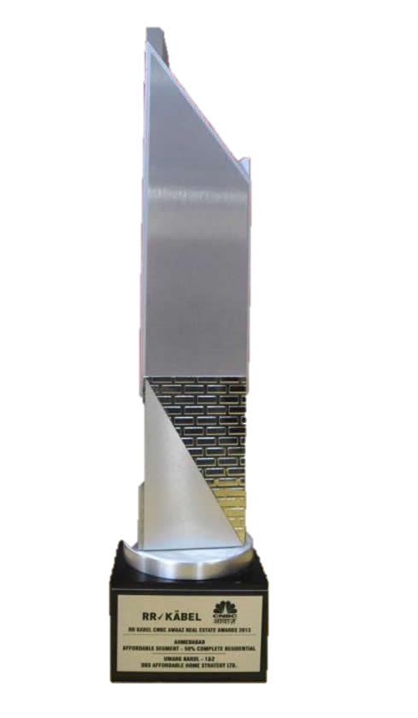
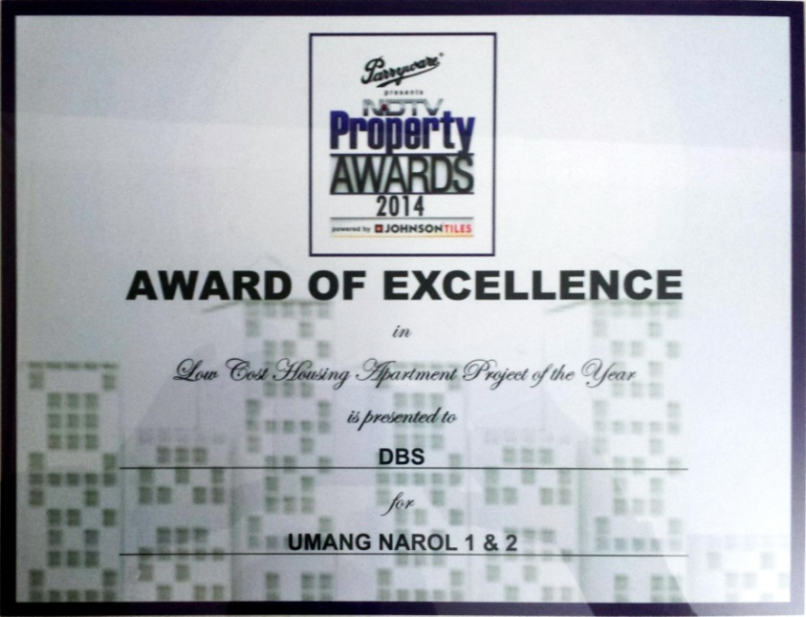
Our Recognitions
4 Star GIIRS ratings
Received the
NDTV Property Awards 2014
for project Umang Narol-1 & 2
Received the
Certificate of Merit for Affordable Housing of the Year by DNA Real Estate & Infrastructure Awards
Won the
CNBC AWAAZ Real Estate Awards 2013
for project Umang Narol-1 & 2 for being the Best 50% Complete Residential Project under Affordable Segment in Ahmedabad city

Slide 8
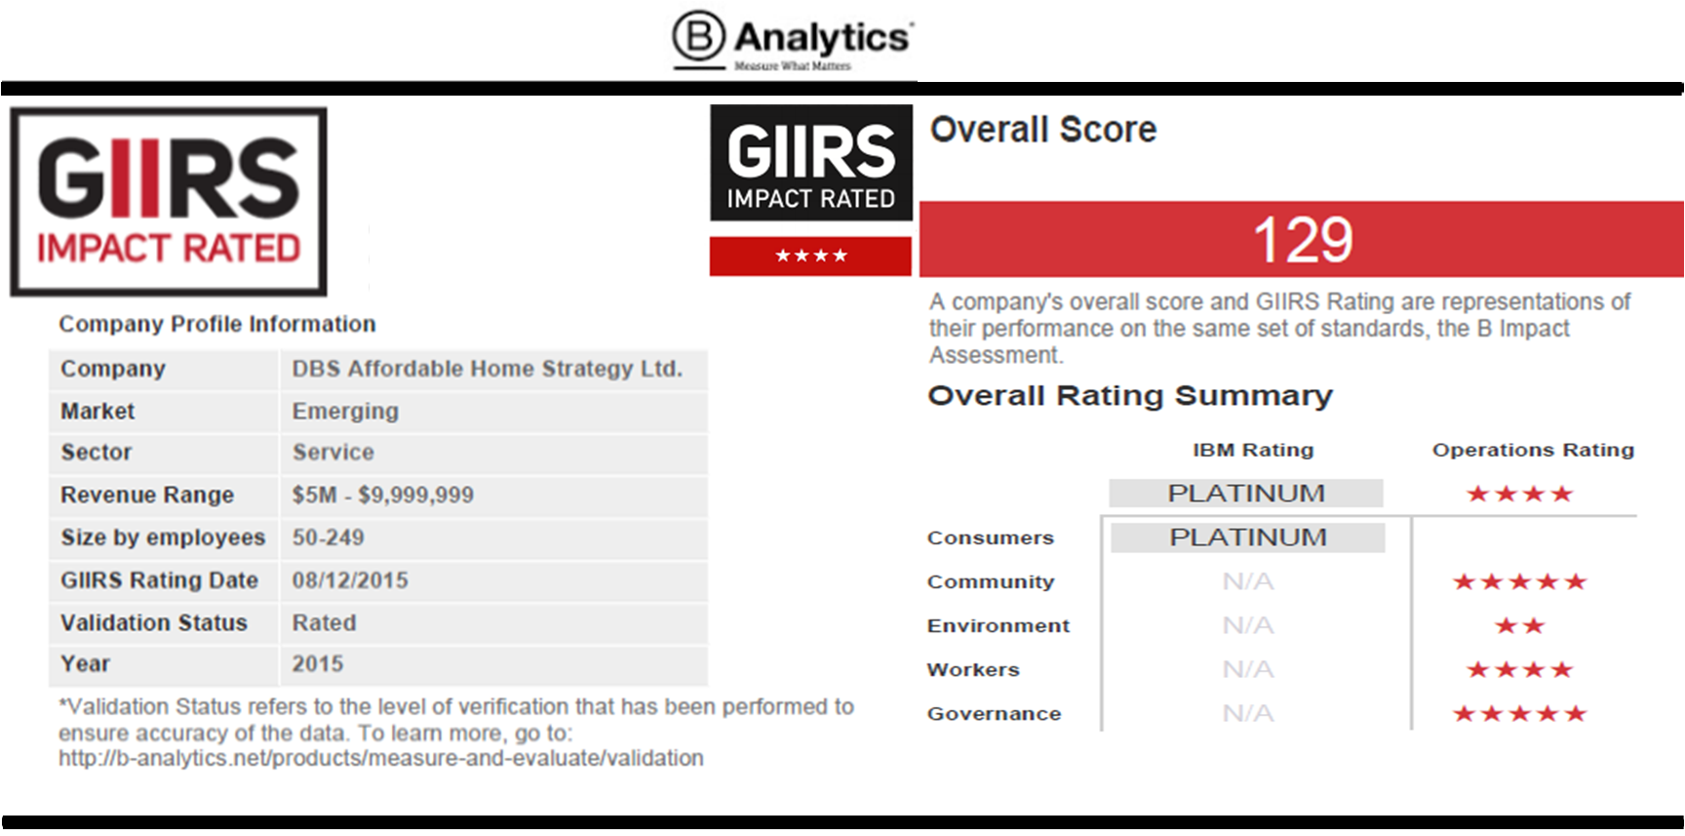
DBS received GIIRS 4 star rating for 2015-16
The Global Impact Investing Rating System (GIIRS) ratings provide investors with a rating of a Company’s social and environmental impact. GIIRS Ratings are the gold standard for impact measurement in impact investing. GIIRS Ratings are rigorous, comprehensive, and comparable ratings of a company or a fund’s social and environmental impact.

Slide 9
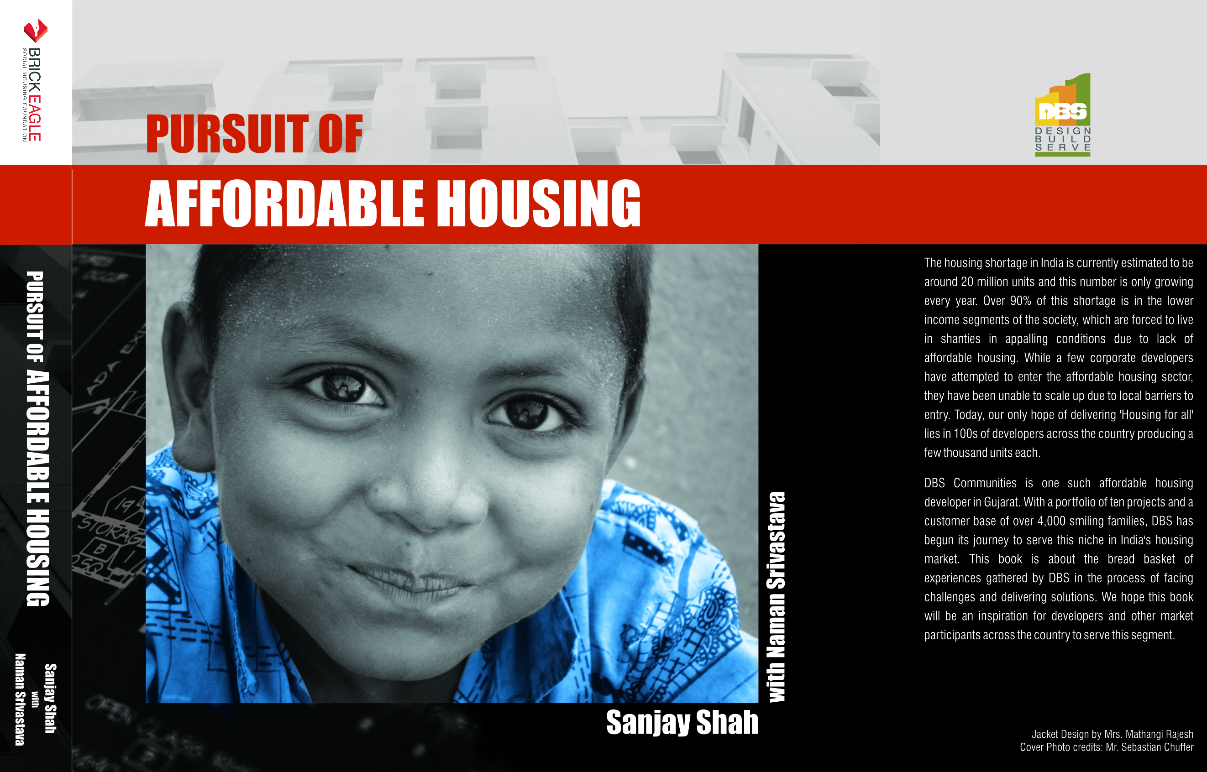
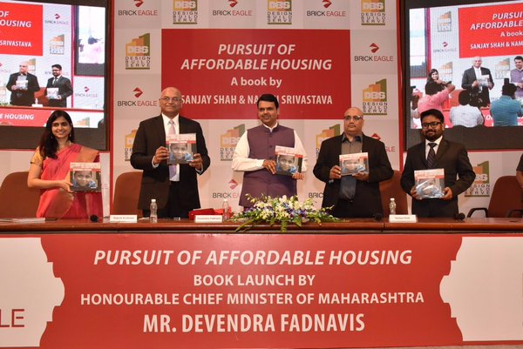
Book Launch
Launch of book “Pursuit of Affordable Housing” written by Sanjay Shah with Naman Shrivastav by the hands of Hon'ble Chief Minister of Maharashtra Mr. Devendra Fadnavis on Feb 3, 2016.

Slide 10
Our Projects
Own Projects
Projects | Total Units | Launch Date | Status
Umang Lambha | 792 | May, 2010 | Completed
Umang Narol 1 & 2 | 885 | March, 2011 | Completed
Umang Vehlal | 207 | August, 2012 | About to complete
Umang Aslali | 407 | October, 2014 | Under construction
Revenue Projects
Projects | Total Units | Launch Date | Status
Umang Aditya | 480 | June 2011 | Completed
Umang Sachin | 868 | February, 2012 | Completed
Umang Narol 3 to 8 | 1866 | October, 2012 | Under construction
Umang Vatva | 515 | July, 2014 | Completed

Slide 11
SWOT
Innovative Business Model
Grip on Housing Finance/ Housing Finance Product along with Customer
Tried/ Tested/ Successful volume base, direct
end user marketing & selling expertise
Involvement of NGO, Understanding of business at grass root level & energetic/ passionate/ committed team
GIIRS rating/ Awards/ Documentation
Strengths
Weakness
Very low capital base business structure
Less exposure to financial closure & expertise
Less exposure to corporate protocols
No access to cheap funds/ Low rate finance
Threats
Opportunities
Right time in country as government is promoting affordable housing,
Market driven and already identified latent demand.
Absence of any national player in the space
With appropriate approach, high volumes can be achieved
Direct supply of government and competing with government
Competition from local substandard, overcommitted players
Local Influence and its possible effect on project execution & time run

Slide 12
Strengths
Innovative Business Model
Only business model which has inbuilt housing finance and community initiatives. The model has been accepted and appreciated by people at bottom of pyramid.
Grip on Housing Finance/ Housing Finance Product along with Customer
As a part of sales and marketing, we help in building strong bridge between Housing Finance Companies and customers. Griha Pravesh is promoted to ease people in the process of housing finance
Tried/ Tested/ Successful volume base, direct end user marketing & selling expertise
DBS has unique capability of making strategies, identifying catchment areas, connecting with end users with the help of NGO & local players. Its expertise lies in exhibiting the project in a language which is easy and understandable to the customers
Involvement of NGO, Understanding of business at grass root level & energetic/ passionate/ committed team
DBS has always had the approach of keeping customers in the centre with appropriate product; which has helped us in gaining knowledge and first hand learnings. DBS team has driven by cause and not been completely commercial/ professionals.
GIIRS rating/ Awards/ Documentation
DBS has acquired international impact rating and made its presence in impact investors world and has also been acknowledged by many awards & government facilitation.

Slide 13
Weakness
Very low capital base business structure
DBS was started & managed with a capital of less than 2 crores, against aspiration of building 50000 homes in 7 years. This has made the company financially unstable. The timely support of equity was not received as was planned or desired.
Less exposure to financial closure & expertise
By keeping Complete focus on experimenting and learning affordable housing business we made blunder by not strengthening the financial vertical and did not learn financial discipline over a period of time.
Less exposure to corporate protocols
We have now realized the importance of learning corporate protocals and formats which is essential to grow. In the past, absence of the same has made us ineligible to corporate investors who only see and understand numbers.
No access to cheap funds/ Low rate finance
Due to insufficient working capital company has to opt for traditional , informal and costly borrowings. Infact in 7 years, DBS has not got bank finance due to ignorance on financial closures.

Slide 14
Opportunities
Right time in country as government is promoting affordable housing,
With the Prime Minister’s vision of ‘Housing for All by 2022’ , the awareness, aspirations, facilitations has increased. This has in turn also led to increased aspirations of people at the bottom of pyramid.
Market driven and ample of latent demand identified
According to statistics, the country needs 20 million homes and there are limited structured players in the industry supplying the right product at right price. This creates ample opportunities for business
Absence of any national player in the space
Affordable Housing has seen many local players, however there has been an absence of any national player thereby having scope of creating a strong brand with little different approach
With appropriate approach, high volumes can be achieved
With the growing population, increasing urbanization and growing needs of housing, volumes will always be increasing.

Slide 15
Threats
Direct supply of government and competing with government
The subsidized homes supply sometimes misleads the end users. The announcements made by government are also not understood in its proper manner hence creating pressure on business and selling.
Competition from local substandard, overcommitted players
In the past few years, with the concept of affordable housing becoming popular, and with the slow demand in main stream real estate; many non committed players have entered into this space making the market polluted.
Local Influence and possible effect on project execution & time run
Local negative leaders, politicians, approving authorities and corruption can harm the project execution.

Slide 16
Why DBS still needs Strong Financial Partner
DBS has become non profit enterprise, even though we did not plan that way neither did we anticipate that way.
DBS has directly constructed 11,60,744 sq feet and 42,58,485 sq feet in partnership. Theoretically we should have lots of money in the account, but inspite of our strong execution record we haven’t been able to achieve financial stability.
The company is top heavy and over capatized so even after our individual projects have made profits ultimate financials were negative.
Inconsistency of project pipeline/ volumes has directly affected the financial cash flow. Hence, the need for backup/ access to cheap fund becomes a necessity for the survival.
Since 2013 we were looking for a financial partner to overcome above difficulties, with the same wavelength as us and strong financial capability; hence partnered with Brick Eagle in early 2015. But for unknown reasons they could not infuse required capital or reasonable debt in time.

Slide 17
Collaboration Possibilities
Option 1
Mahindra Lifespace invests in flagship company DBS Affordable Home Strategy Limited (where Brick Eagle has invested), in equity upto their comfort and operational ease. All project SPV’s can be subsidary of this company (At present, Vadodara SPV is planned in a similar way) and bring all required fundings as debt till you have complete financial understanding of company.
Option 1 A
For easy execution or making it acceptable in M & M board/ group, we can also think of taking over whole company OR merging with any entity OR dismantle old company in such a way that we can use its track record.
Option 2
For the time being, Mahindra lifespace can come at Vadodara project level, as this project is in comfortable stage from fisibilty and approval dimensions so it may be easy to convince board. After which, slowly from the bottom you can get into main company as and when needed or you become comfortable

Slide 18
Collaboration Possibilities
Option 3
We create complete new entity and wind up old structures over couple of years. So it can be started with fresh, ideal frame work and we can use team, expertise, project in pipeline and existing project in different format
Option 4
Any other new ways and means suggested by you or to be discussed in this meeting

Slide 19
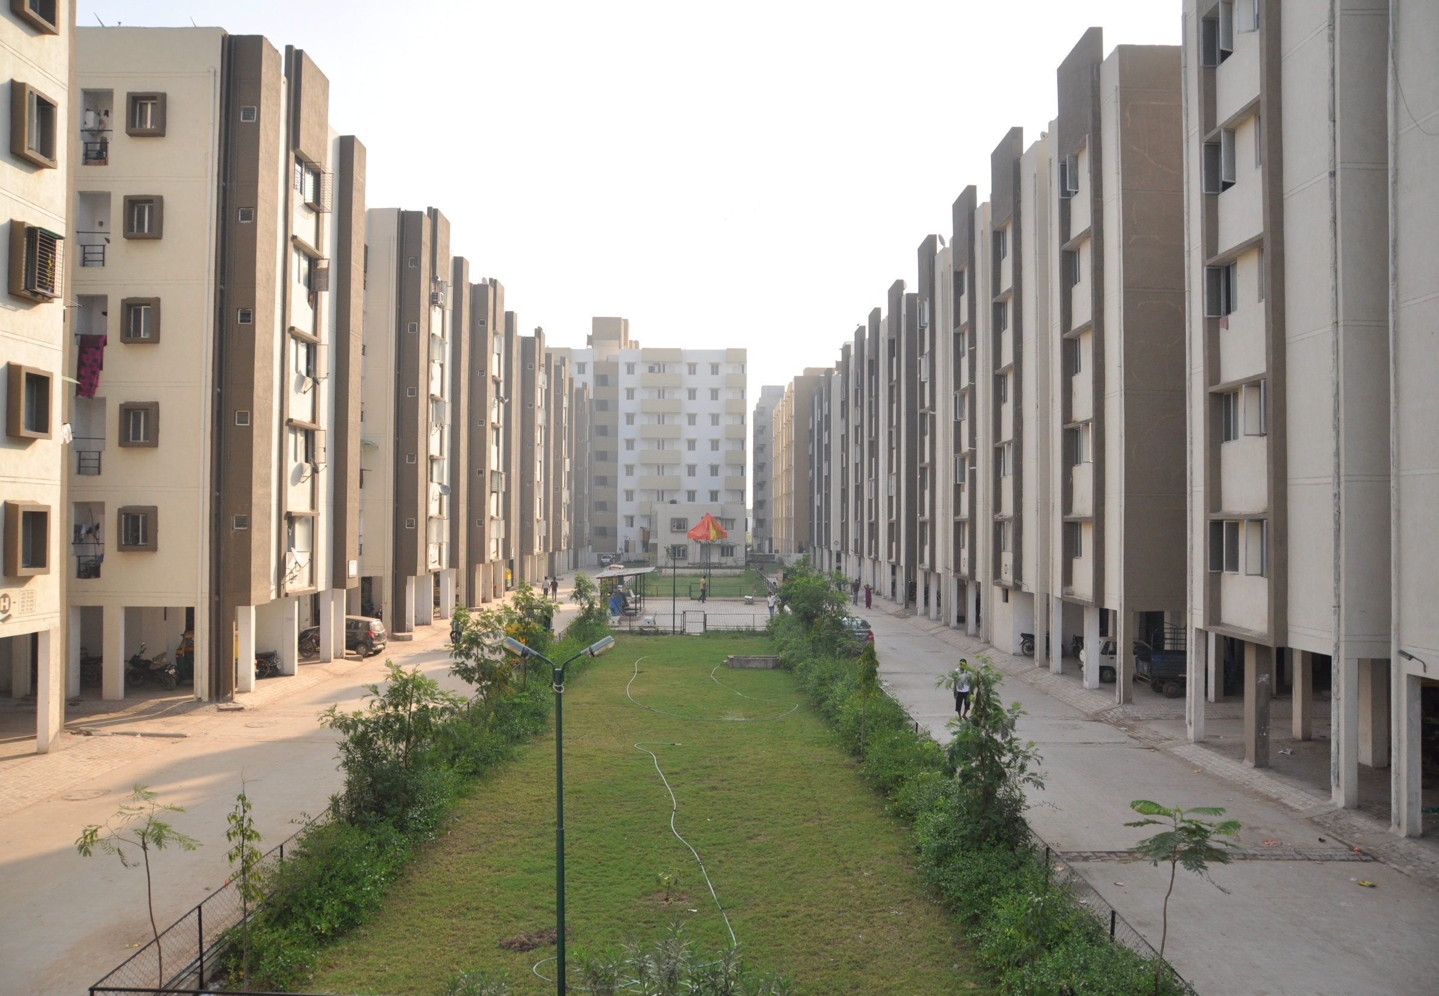
…Thank You
DBS Affordable Home Strategy Limited
Plot No. 130, Moje Por, Adalaj-Koba Highway, District Gandhinagar, Gujarat - 382421
www.dbscommunities.com
Toll Free : 1800-123-6007 | SMS : “UMANG” to 56767

