Slide 1



Griha Pravesh
– Enabling Affordable Housing Ecosystem

Slide 2
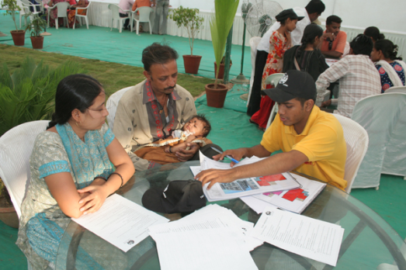
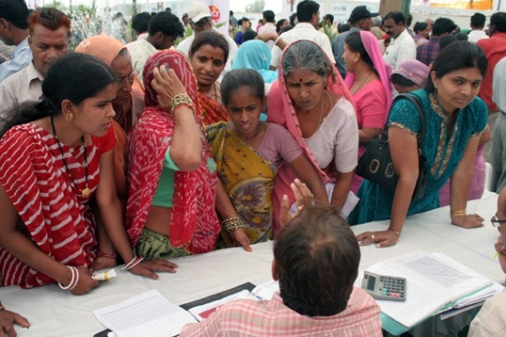
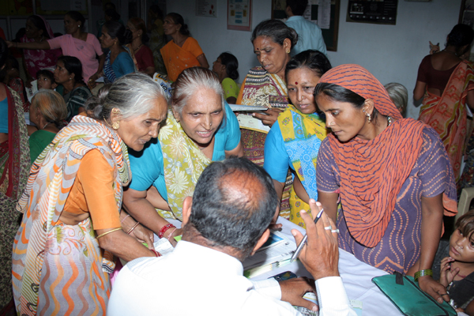
How nice it will be if we could have our own house…
Have you seen the application form? … It is so complicated
Who will give me loan?
But where should I buy the house?
How much stamp duty do I have to pay?
What is Super built up?
What is Form 16?
I don’t have a bank account or salary slips. Can I still buy a house?
Can some one help us?

Slide 3
Affordable housing - Griha Pravesh
Facilitate provision of affordable houses to those to those who are unable to access housing through formal channels through tie ups with affordable housing developers and housing finance institutions
Purpose | To empower people from urban low income areas and facilitate them to buy their own homes
Target segment | People working in the informal sector with an aspiration to buy their own homes
Social impact | People moving into a safe and secure environment with their families, having a legal property in their name
Future plans | Establishing Griha Pravesh role as an ecosystem in the affordable housing market in the country
Educate the community, by making as many GP Members as possible,
Help clients build a credible financial track record
Facilitate smooth and speedy provision of housing finance to the client
Document case studies on client experience of housing facilitation
Share facilitation experience with other potential associate organizations
Seek partners and stakeholders to replicate facilitation model in other parts of the country

Slide 4

Griha Pravesh
Timeline
2011
Griha Pravesh Initiaited in Ahmedabad
2012
Operations expanded to Surat
2013
2 Community Centres in Isanpur and Bapunagar areas of Ahmedabad
2014
Operations shifted to Head Office in Jodhpur, Ahmedabad
2015
Customised Software Development
Operations expanded to Mumbai city
Finalising Training Modules on Housing Finance and Facilitation

Slide 5
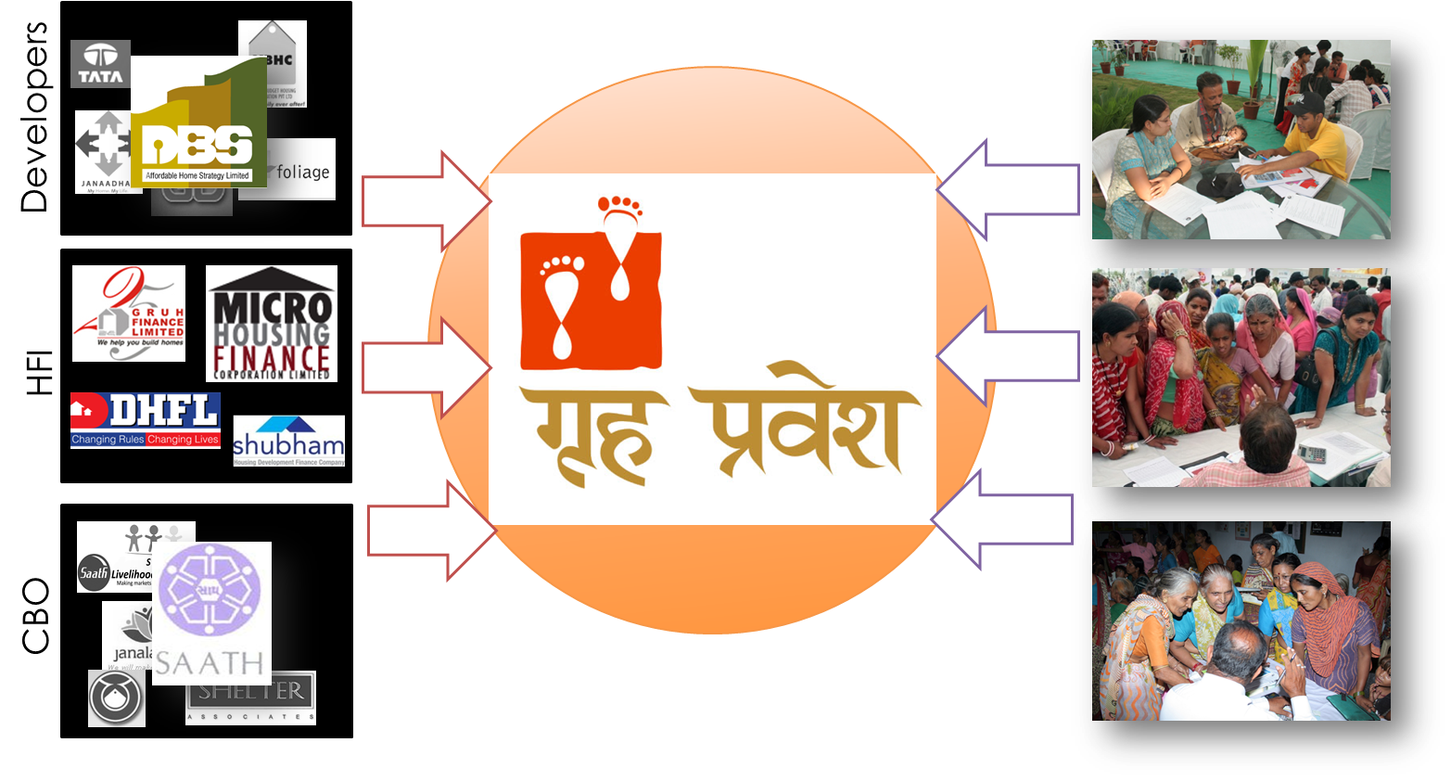
The Mission – Enabling Affordable Housing Ecosystem
Griha Pravesh equips potential buyers to make the right choices & hand-holds them through the process of buying a house

Slide 6

Functions
The Mission – Enabling Affordable Housing Ecosystem
Griha Pravesh equips potential buyers to make the right choices & hand-holds them through the process of buying a house
There are three key roles that the proposed housing facilitation centre is expected to play:
  Facilitate clients to make more informed decisions about their house purchase;
  Facilitate provision of housing finance and margin money assistance to borrowers.
  Facilitate integration of community development initiatives with housing
Dissemination Campaigns
Asset creation, and Livelihood Enhancement
Documentation
Financial literacy
Skill up-gradation, education and health
Home maintenance
Housing Association Formation
Engaged Facilitation
Client : From house selection to registration of Documents
Developer : market scan to Housing society Maintenance
HFIs: Client introduction to dispersal

Slide 7
Stages of Customer Interaction
Step 1
Customer becomes a member
Step 2
Detailed survey of the customer
Step 3
Address verification
Step 4
Guidance based on diagnostic report
Step 5
Connect to community development programs
Verification of KYC
Step 6
Selection of home/ Site Visits
Step 8
Application for loan
Step 9
Loan process & disbursement
Step 10
Home registration & stamp duty
Step 11
GRIHA PRAVESH
Saving of Margin Money
Step 7

Slide 8
Activities undertaken by Griha Pravesh
With Clients, Developers, Housing finance agencies
Area Mapping, Area Profiling, House hold surveys, Stalls, road shows
Credit camps, need based survey
Maintain the data collected and feed it in software.
Door to door marketing, counselling and relation building with the communities
Pre Launch and Launch activities for the developers.
Loan facilitation process for the customers.
Livelihood enhancement counselling
Facilitate the home buying process for the Griha Pravesh members
Linking daily wagers at the developers sight with various Government and non Government facilities.
Community development initiatives and society formation for the affordable housing projects.
Loan Approval Process and Disbursement in Surat

Slide 9
Strength of Griha Pravesh, Trained Team
Development of Systems and Modules for training and SOP for various activities
Team building
Level 1 Modules
  Housing and Poverty
  Why Griha Pravesh
  Operations
Level 2 Modules
  Housing Finance – making the right match
  Community development initiatives – SAATH and other programs
  Housing Projects
Level 2 Modules
  Personality development, presentation & office etiquette,
  Communications
  Customer Interaction
  Marketing and Sales
  Basic computers
  Basic English,
  Finance & budgeting Team building and leadership training

Slide 10
Griha Pravesh
Current Status
3 Griha Pravesh centers in Gujarat, 1 at Ahmedabad and 1 at Surat, Sachin and 1 centre in Kalyan, Mumbai
12 committed Team members in 2 states
Database of more than 66,209 people from target income groups
1,854 Griha Pravesh Members, keen to but home ( Paid fees)
853 Home buyers in three cities
Tie up with 18 affordable Housing Developers and 24 Housing Schemes at Ahmedabad and Surat
Linkages with 6 Housing Finance Institutions
Expertize in launch and pre launch activities for affordable housing
Completed partnerships with 2 developers wherein Griha Pravesh took the entire activity from area mapping, need based survey, door to door marketing, pre launch and launch activity to selling of the houses.
Customized software for effective Data base management

Slide 11
Distribution Network of Griha Pravesh
45 Umang SAATHI, A Social Housing Facilitator/Entrepreneur
  Local community leaders
  Anganwadi worker
  Home Buyer-GP
  LIC agents
Women Co-Operative Microfinance
Different NGOs field worker
G-Auto rickshaw associations
School Van association

Slide 12

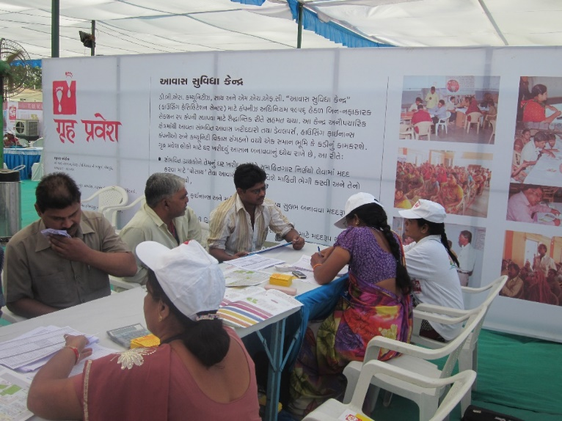
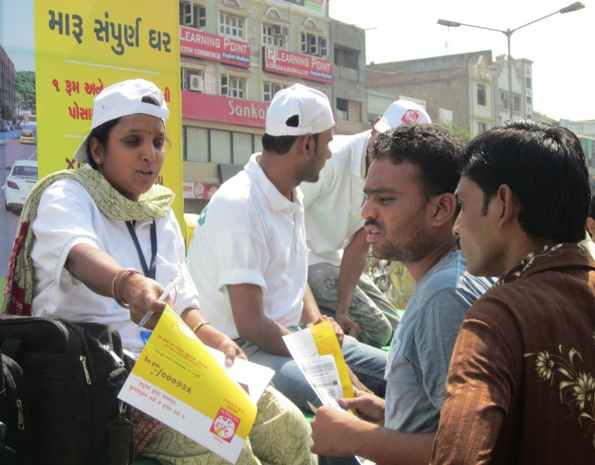
Activities
Pre Launch
Seminar
Road Show for Marketing

Slide 13
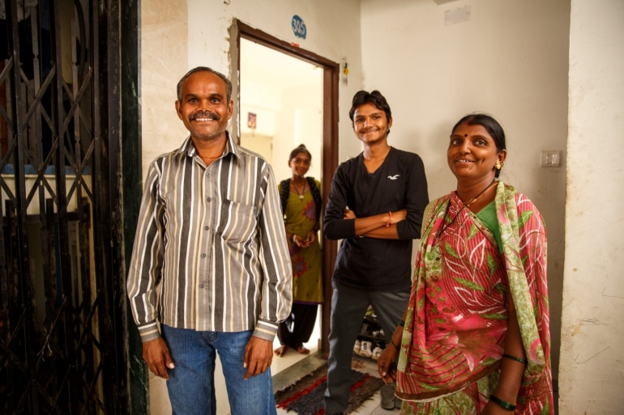
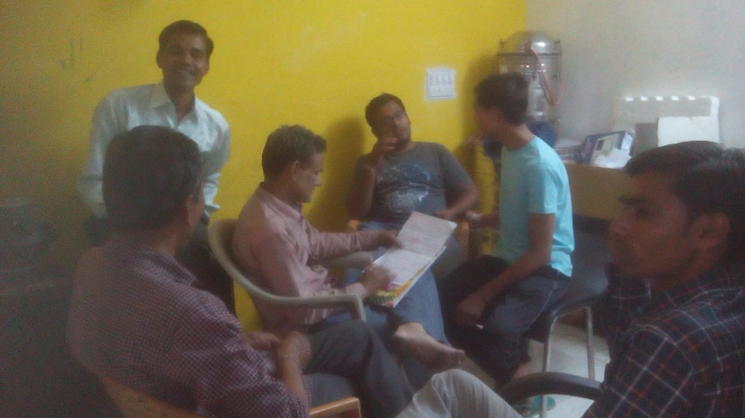
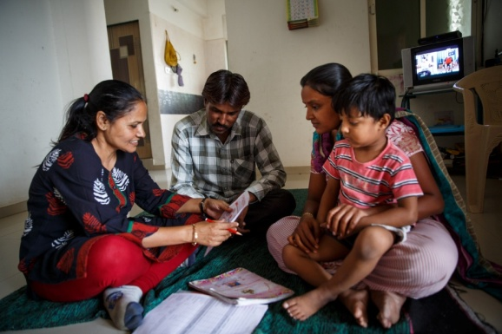
Activities
Home Buyer
Committee Meeting
Membership

Slide 14
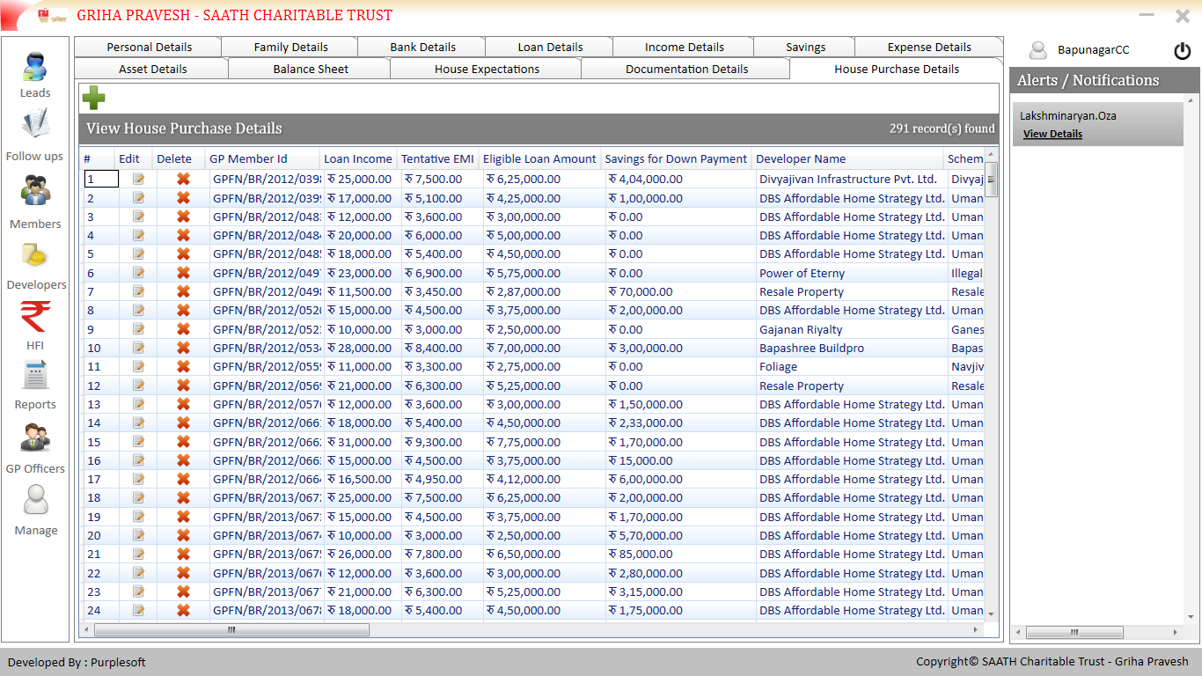
Customised software for data base management

Slide 15

Thank You
Saath Livelihood Services
O/102, Nandanvan – V, Near Prernatirth Derasar, Jodhpur, Ahmedabad-15 Ph: +91-79-26929827
Email: rajendra@saath.org +91-9825005198
Skype: rajendra-joshi
Web: www.saathlivelihoods.org, www.saath.org

