Slide 1
www.GruhSaathi.com
India’s First & Foremost Rapid Mass Affordable Housing Distribution Brand
Ahmedabad, Vadodara, Surat, Mumbai, Thane, Pune, Jaipur, Udaipur, Kota, Bhopal, Indore, Jabalpur, Ghaziabad, Ranchi

Slide 2
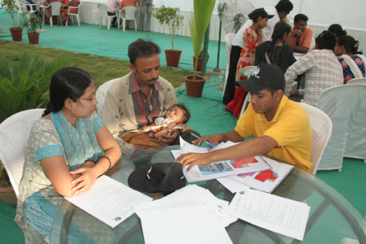
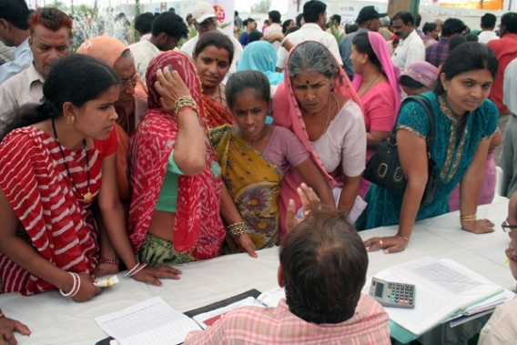
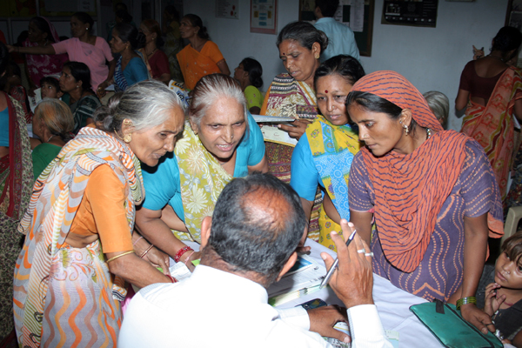
How nice it would be if we could have our own house…
Have you seen the application form? … It is so complicated
Who will give me loan?
But where should I buy the house?
What is Super built up?
How much stamp duty do I have to pay?
What is Form 16?
I don’t have a bank account or salary slips. Can I still buy a house?
Can some one help us?

Slide 3
Griha Pravesh - Enabling Affordable Housing Ecosystem
Facilitate provision of affordable houses to those who are unable to access housing through formal channels - through tie-ups with Affordable Housing Developers and Housing Finance Institutions. Griha Pravesh helps potential buyers in making the right selection & hand-holds them through the process of home buying.
Purpose To empower people from urban low-income areas and facilitate them to buy their own home
Target Segment People working in the informal sector with an aspiration to buy their own home
Social Impact People moving into a safe and secure environment with their families, having a legal property in their name

Slide 4
Griha Pravesh - Stages of Customer Interaction
Step 1
Customer becomes a member
Step 2
Detailed survey of the customer
Step 3
Address verification
Step 4
Guidance based on diagnostic report
Step 5
Connect to community development programs
Verification of KYC
Step 6
Selection of home/ Site Visits
Step 8
Application for loan
Step 9
Loan process & disbursement
Step 10
Home registration & stamp duty
Step 11
GRIHA PRAVESH
Saving of Margin Money
Step 7

Slide 5
Griha Pravesh - Current Status
2 Griha Pravesh centers in Gujarat, 1 at Ahmedabad and 1 at Surat, Sachin and 1 centre in Kalyan, Mumbai
12 committed Team members in 2 states
Database of more than 66,209 people from target income groups
1,854 Griha Pravesh Members, keen to buy home (paid fees)
853 Home buyers in three cities
Tie-up with 18 affordable Housing Developers and 24 Housing Schemes at Ahmedabad and Surat
Linkages with 6 Housing Finance Institutions
Expertize in launch and pre-launch activities for affordable housing
Completed partnership with 2 developers wherein Griha Pravesh took-up all activities right from area mapping, need-based survey, door-to-door marketing, pre-launch & launch activities and upto selling of houses
Customized software for effective Database management

Slide 6
Griha Pravesh - Timeline
2011
Griha Pravesh Initiated in Ahmedabad
2012
Operations expanded to Surat
2013
Two Community Centres in Isanpur and Bapunagar areas of Ahmedabad
2014
Operations shifted to Head Office in Jodhpur, Ahmedabad
2015
Customized Software Development
Operations expanded to Mumbai city
Finalizing Training Modules on Housing Finance and Facilitation

Slide 7
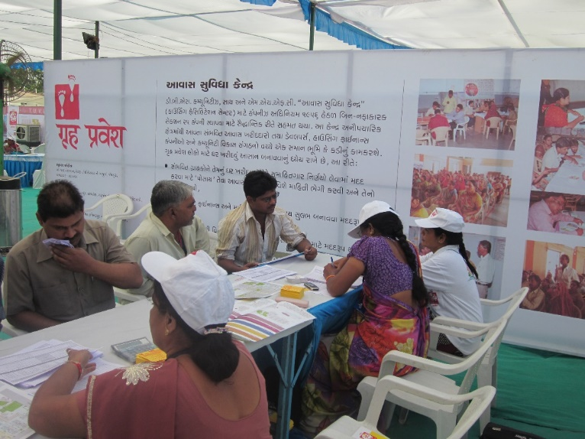
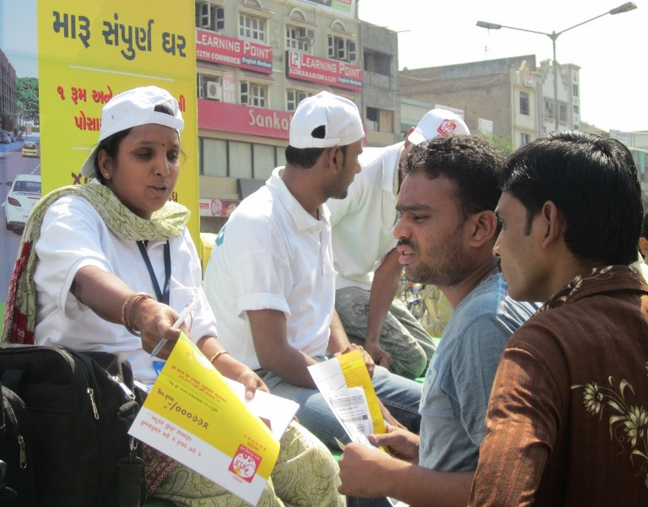
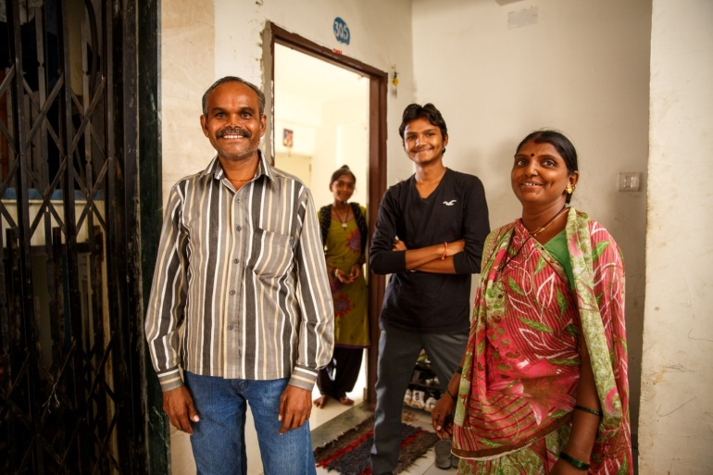
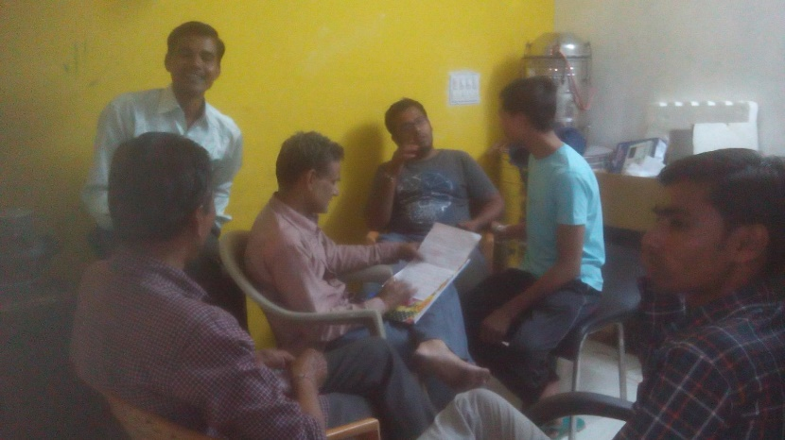
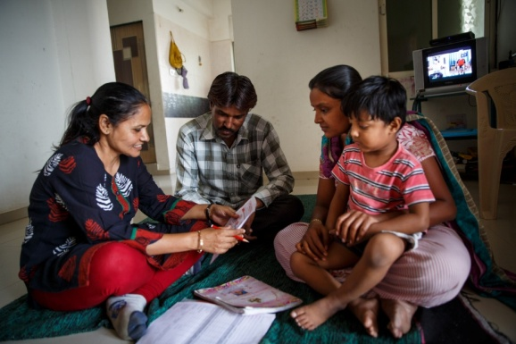
Griha Pravesh - Activities
Seminar
Pre-Launch
Road Show for Marketing
Home Buyer
Committee Meeting
Membership

Slide 8
Why Gruh Saathi
www.GruhSaathi.com
As first hand observers of the Affordable Housing Industry through years, we at DBS, have felt a huge vacuum in the space called “Customer Acquisition”.
Neither the right product is created, nor it is marketed to the grass-root level Customers in a medium in which the Affordable Housing Customers can understand and accept which is in a simple language & format.
Because of this, we believe, lots of Developers have moved into a little upper segment of the market although they started with real Affordable Housing.
Currently there is no tool, medium or platform available in the market which focusses Exclusively on Affordable Housing “Customers” or “End-Users”.
Today when the Government is heavily promoting an Affordable Housing Movement as its priority Agenda / Mission, it becomes a must to have a platform which can “Aggregate Customers” by reaching out to them with the right spirit, product and support…

Slide 9
What is Gruh Saathi
www.GruhSaathi.com
Gruh Saathi is a revolutionary effort to achieve ‘Housing for All’ keeping ‘Customers’ in focus.
Gruh Saathi is a Commercial Business Model having:
On-ground Support from NGOs and MFIs
Competent Marketing & Event Management Team
Creativity in Modelling Financial Loans as well as Product Design Standardization
Online Platform with the latest E-Commerce Technology and Principles
Rapid Scalability as a Nationwide Brand
Solutions to convert Latent Demand into Real Demand

Slide 10
Why DBS
www.GruhSaathi.com
DBS is the only focussed Developer working in the Affordable Housing space keeping customers in mind
DBS has survived 7-8 years, delivered @ 4000 homes and have interacted with half-a-million potential customers during these years
By now, DBS knows the target customers first hand - possibly much better than anyone else in the country
DBS has sound experience joining hands with local NGOs and on-ground people – training them quickly, motivating them and getting the desired outcome from them

Slide 11
Our Target Customer Groups
www.GruhSaathi.com
Household Incomes from Rs. 30,000 to Rs. 50,000 per month, mainly they will come from below listed segments:
Government & Semi-Government Office - Class-3 & Class-4 Employees
Hospital Employees - Class-3 & Class-4
Schools and Colleges Employees - Class-3 & Class-4
Industry Staff and Workers
Office Employees – Base Level
BPO / Call Centre Employees – Base Level
Informal Sector Owners (Shopkeepers, Garage, Vendors, Service Providers, & their Employees)
Defence Services – Base Category Employees
Railways – Base Category Employees
Transport Service Operator Employees – Truck, Taxi & Rickshaw
As DBS, we have touched many of the above segments in a smaller way so we know their characteristics well

Slide 12
Gruh Saathi Product & Price Offering to Customers
www.GruhSaathi.com
Typical Affordable Housing Size Range
1 Room-Kitchen Apartments (1RK)
2 Room-Kitchen Apartments (2RK)
3 Room-Kitchen Apartments (3RK)
Affordable Housing Price Range*
Rs. 5 Lakhs to Rs. 10 Lakhs
Rs. 10 Lakhs to 15 Lakhs
Rs. 15 Lakhs to 20 Lakhs
Rs. 20 Lakhs to 30 Lakhs
* Depending on City & / Location of the Project

Slide 13
Our Primary Business Model
www.GruhSaathi.com
Affordable Housing
Customers & End-Users
Post Sales
Services
Range,
Right Price, Transparency, Home Loan, Margin Money
Latent
Demand,
Needs &
Expectations
Range, Quality Assurance
& Timely Delivery
Homes,
Home Loans & Transparency
Outreach, Aggregation
& Advocacy
Gruh
Saathi
Volume, Marketing & Sales,
Co-Branding, Standardization
Training, Publicity, Sales
Support, Revenue Generation
Customers
Needs & Expectations
Gruh Saathis
NGOs & MFIs
Channel Partners
Small & Medium Affordable Housing Developers
GRUH SAATHIs,
NGOs & MFIs
Potential Customer Volume

Slide 14
Gruh Saathi Assurance to its Customers
www.GruhSaathi.com
Gruh Saathi provides Confidence to Customers by Assuring that:
Housing Finance is made available to all customers
Govt. Subsidy to Customers is fully facilitated
Project Title & Other Legal Documents are Clear and Complying
Grievances / Complaints are addressed on time through a forum
Projects offered to customers are Rightly Priced
Co-Branded Developer is credible enough
Designs and Amenities are made as committed
Quality of Materials used and its Workmanship Standards are maintained
Possession is given to customers on-time
Click to Know More

Slide 15
Gruh Saathi Offerings & Assurance to Developers
www.GruhSaathi.com
Marketing & Sales of their Inventory
Promotional Launch Events
Marketing through Kiosk, Roadshows, Door-to-Door Marketing, Newspaper Ads, Leaflets, Posters, Hoardings, Radio Jingle, Cable TV Ads, TV Commercials, etc.
Developer Project Finance
Pre-sanction and Credit facilitation
Collected data fed into software and analysed, Calling and follow up of the data collected
Site visit for potentially shortlisted customers falling into the pre-decided criteria
Conversion of potential customer into home buyers
Community Development Initiatives and post-possession society formation
Area mapping and profiling, need-based market survey and analysis
Develop customized marketing tools
Grievance resolution for bridging the gap between customers and developer

Slide 16
www.GruhSaathi.com
Gruh Saathi Offerings & Assurance to Housing Finance Institutions (HFIs)
Access to a large potential customer base due to Gruh Saathi’s engagement with many developers and large number of potential affordable home buyers across multiple cities in the Gruh Saathi network - Extended outreach across locations
Increased Business Opportunities
Aggressive Participation during Gruh Saathi Events / Melas leading to innovative and competitive financial products
Collection of EMIs on time from customers due to presence and interaction of Gruh Saathis and NGOs
Assured very low default ration due to presence and interaction of Gruh Saathis and NGOs with customers
Can associate themselves with NGOs, MFIs and Saathis for customer due diligence, loan facilitation and KYC documents
Increased access to customers leading to cross-functional sales of other HFI offerings to customers

Slide 17
www.GruhSaathi.com
Gruh Saathi Offerings & Assurance to NGOs & MFIs
Donations & Employment Opportunities
Database of Clients for calling and follow-up, Extended Outreach to Potential Customers
Standardised Awareness and Training programs from Gruh Saathi for Teams involved in the process
Access / outreach to more no. of people who can enrol and avail NGO’s / MFI’s regular services
Identification of Gruh Saathis – Connecting platform
Field activities for Launch and Refresher Events
Nodal NGO can work with other NGOs/MFIs in a local geography
Co-branding Opportunity
Access to CSR funds of large Developers
Gruh Saathi Offerings & Assurance to Gruh Saathis
Additional income through sale of houses
Trainings on various aspects of sales
Social status enhanced
Feet on ground for social marketing of affordable houses and similar products
Heightened self-esteem as they are involved in a social good/purpose

Slide 18
www.GruhSaathi.com
Gruh Saathi Aligning Possibility with Government
Marketing of Projects– similar to developers
Identification of customers according to scheme criteria
Distribution / Allocation of houses according to scheme criteria
Gruh Saathi Offerings to Others - Insurance Companies
Large customer base for affordable insurance products
Insuring risk for affordable housing risks for individuals
Co-branding opportunities
Gruh Saathi Offerings to Others – Dealers of Household Appliances, Automobiles & Furniture Manufacturers
Large customer base for affordable products
Co-branding opportunities
Design products, especially furniture for affordable housing needs

Slide 19
How Gruh Saathi helps Customers Buy their Affordable Home
www.GruhSaathi.com
Customers wanting to Buy their Affordable Home are
aggregated by www.GruhSaathi.com Platform at Monthly Events
Potential (Interested & Registered) Customers are Counselled & made aware of the various options & possibilities along with offerings available to them for buying their home.
Regular Gruh Saathi Promotional Offers are kept, Free Home Allocations,
Brand Ambassador and Alliance with Marketing Agencies for Continual and Penetrated Marketing would be carried out
Potential Customers (registered), based on their interest,
Visits the opted / nearest available GruhSaathi Co-Branded Project
Front-end Activity Flow w.r.t. Customers
Potential Customer Selects & later Books his / her Apartment at the GruhSaathi Co-Branded Project
on the Gruh Saathi Portal with due assistance from a GruhSaathi (Customer makes direct payment to Gruh Saathi)
The GruhSaathi hand-holds and supports the Customer through the following:
Booking Process
Margin Money Arrangement, if required (thru MFI / Crowd Funding, etc.)
Selection of HFI, Loan Approval & Sanction, followed by Processing, as may be required
Applying for Subsidy Schemes – PMAY, etc. as available
EMI Collection, Regular Reminders & Periodic Updates on Progress of Work & Next Stage of Activities
Preparing for Possession - Legal Documentation
Handing-over of / Possession Process
GruhSaathi Customer starts living in his / her own GruhSaathi Home
& becomes a mentor to other potential customers – GruhSaathi then Connects them with
other GruhSaathi Services incl. Community Development (NGO) / Income Increment….

Slide 20
How Gruh Saathi helps Affordable Housing Developers
www.GruhSaathi.com
Mass Media Publicity to Invite Interested Small & Medium Affordable Housing Developers across the locations
Small & Medium Affordable Housing Developers Call Gruh Saathi and show their Interest in Co-Branding (Existing / New Projects)
Our Corporate Developer Business Development Team Visits the Developer & his Project to see if they fit into our criteria
Our Concept is Presented - Requirements & Benefits are stated. If they are interested to offer their Existing Project(s), we shall Scrutinize their Legal Compliance, carryout a Physical Compliance Audit and also verify the project against our Criteria / Standards. We shall also Report on Additional Provisions to be made. They are then invited to the next Gruh Saathi Event to be held in their City (either to participate / just see the response)
Front-end Activity Flow w.r.t. Affordable Housing Developers
Agreements are Signed with them to Offer their Product as a Co-Brand Partner of Gruh Saathi, at a Pricing, Provisions to be made as per Compliance Report are followed through before their Listing on our Portal
Developer Project gets Listed on our Portal & Mobile App, Announcements / News is circulated to Gruh Saathi Teams across of the new addition, Project / Unit Availability Search Results would now showup on our Portal / Mobile App based on criteria
Developer Staff is Trained in Meeting with Customers, Displays & Signages are put-up at their project as a Co-Branded Gruh Saathi Partner. Developers can setup their Stall with offerings at the next Gruh Saathi Event
The Sales & Project Progress gets constantly monitored & supported – Sales gets Registered - Other Support Services are also offered – Project Construction Finance, Marketing Team, Arch. & Engg. Services Support, Approval Support, etc. as required
Developers can also approach us with New Projects – we shall guide them Build & Deliver the Project based on Gruh Saathi Criteria

Slide 21
How NGOs & MFIs would engage with Gruh Saathi and get benefitted
www.GruhSaathi.com
NGOs & MFIs working with Target Customer Groups would be invited for Concept Presentation and How they can Contribute towards and get benefitted
If they are Interested in the Concept, they are Enrolled based on our Criteria for Registration of NGOs & MFIs considering: Locality of their Operation and Outreach, Target Customer Group with who they are working, No. of Associates / Team with them and What services they are currently offering and whether they can get aligned with us
Agreements are Signed with them to Offer their Product as a Co-Brand Partner of Gruh Saathi, Pay-outs Decided, Team Ramp-up and other Provisions as per our Requirements from NGO followed through and later their Listing on our Portal as Co-Brand NGO
NGO Teams (now on called Gruh Saathis) are Trained for Soft Skills by Gruh Saathi Business Development Team at their Location
Front-end Activity Flow w.r.t. NGOs & MFIs
Projects Listed in their City are Explained, Terminologies, Booking & Sales Process is Explained (Modus Operandi)
Training provided on Portal and Mobile App usage, Tablets provided to few,
Credentials for Access to Portal and Mobile App are provided
Quarterly Gruh Saathi Events are organized in the city / town / locality with publicity and support from www.GruhSaathi.com
Gruh Saathi Co-Branded Partner (NGO) leads the Event at the venue and Registers Potential Home Buyers on Portal / App
Potential Home Buyers are Presented with Relevant Projects and Housing Loan options available to them
Gruh Saathis interact & convince Potential Home Buyers to Book their Home through Gruh Saathi Platform over a 3-month period
Based on Bookings, the Gruh Saathis & the Co-Branded NGO receives Donations and / Pay-outs from Gruh Saathi Platform

Slide 22
www.GruhSaathi.com
Gruh Saathi Online Support Platforms
www.GruhSaathi.com Web Portal
GruhSaathi Mobile App
Online CRM Platform now & ERP Platform later
Toll Free Number supported by a Call Centre
Social Media platform
Click to Know More

Slide 23
www.GruhSaathi.com
Gruh Saathi On-Ground Support Platform
Gruh Saathi Events
A hugely pre-publicised, One-Day Event organized every 3 months in each city of operation, for inviting Potential Customers to educate them and make them aware that they too could buy their home
In each event, around 3000-5000 Potential Customer Families (15000-20000 visitors / footfalls) are expected to attend
Co-branded Developers, Housing Finance Institutions (HFIs), MFIs & NGOs also participate and potential ones are invited to the event
Events are lead by Gruh Saathis who are supported by Gruh Saathi Ground Support Team
The buying process, the concept and options are explained, Q&A & one-to-one Counselling happens with Potential Customers
Stalls of Co-branded Developers, HFIs, MFIs & NGOs are setup to showcase their offerings, provide details and also attend to any queries
Customers get to know the location, type, size and pricing of unit / project offerings here and also can check their loan eligibility as well as need for micro-finance and its availability
Lucky Draw would be held during Gruh Saathi Event for Customers who book a unit – the winner would get his home free-of-cost
Videos / Short Films (large screen) are run showing interviews of select customers and their experience with Gruh Saathi Platform
Potential Customers are ferried to the interested Project locations during these events to enable them to select / book a unit as suitable
Everyone attending are require to Register (on the System / Mobile App with Name, Surname, Mobile No. & Location) - they would be tracked till they finally book a unit with us
Snacks & Beverages would be served to all attendees during this one-day event (budgeted activity)
Smaller Events are also organized (at specific localities / communities) every monthly for creating awareness and inviting them for the bigger event and also to do some follow-up activities

Slide 24
www.GruhSaathi.com
Gruh Saathi Operational Teams in Background
Business Development Team (Corporate)
Ground Support Team (Regional / Local)
Developer Business Development Team (Corporate & Regional / Local)
Developer Compliance Team (Corporate)
Information & Communication Technology (ICT) Platform Development Team (Corporate)
Media & Publicity (Corporate)
Finance & Accounts (Corporate)
HR & Admin. (Corporate)
Click to Know More

Slide 25
www.GruhSaathi.com
Gruh Saathi Apex Level Organization Structure
Board & Chief Mentor
CEO
CTO
CFO
ICT Head
Media Head
Gruh Saathi Business Development (BD) Head
Developer Compliance Head
Ground Support Head
Developer BD Head
NGO & MFI BD Head
Housing Finance Liaison Head
Arch. & Engg. Services Head
Approval Liaison Head
HR & Admin. Head

Slide 26
www.GruhSaathi.com
Gruh Saathi - Indicative Projections
5000-7000 Potential Customer Footfalls per Event (every Quarterly) per city targeted…
With @ 5% Conversion, @ 250-350 Bookings (within next 3 months) per Event per Quarter
4 Events Every Year per City
Resulting in @ 1000-1400 Bookings per city per year depending upon its potential
Run across 15 Cities in the 1st year, Resulting in @ 15,000-21,000 Bookings in the 1st Year of Operation
With a Database of over 3,00,000 potential customers
At least 1 NGO required per city with 20 Gruh Saathis working under them, so each city has at least 20 working hands and each Gruh Saathi must book at least 4-6 units every month on an average including the bookings made during and after the event
On an Average Every 7th Day Somewhere in the Country - a Griha Saathi Event would get organized
Total of @ 60 Events would be organized in the first year of Gruh Saathi operation
In the 2nd Year @ 45 Cities across India would be covered and @ 50,000 Bookings would be made…

Slide 27
Gruh Saathi Revenue Model
www.GruhSaathi.com
Main Revenue Source - Direct Marketing Pay-out from Developer (as a %) or Unit at a Discounted Price from Developer against Market Price
Other Revenue Sources – e.g. Event Sponsors, Ads, Architectural & Engineering Services, Approval Services, Channelling Service Providers (Furniture & Maintenance Services for Customers), Building Material Bulk Booking for Small & Medium Developers due to platform volume
Gruh Saathi Growth Pattern
Under Construction…

Slide 28
Major Expense & Revenue Heads
www.GruhSaathi.com
CAPEX Heads
OPEX Heads
Revenue Heads
Click to Know More

Slide 29
Social Impact that Gruh Saathi would make
www.GruhSaathi.com
Nearly 20 million Indian households require basic decent housing. Access to decent, affordable housing would provide critical stability for these families, and lower the risk that vulnerable families become homeless.
Affordable Housing enables Asset Creation and Economic Security and hence leads to better:
Stability & Education for Children
Stability & Family Healthcare
Neighbourhood
Safety and Security for Women and Children
Social Status and Self Esteem
Housing for Seniors
Transportation Cost Reduction
Energy Efficient Clustered Housing Projects
Employment Generation
Click to Know More

Slide 30
Gruh Saathi FAQs
www.GruhSaathi.com
Customer FAQs
Developer FAQs
Project FAQs
NGO & MFI FAQs
Gruh Saathis’ & Channel Partner FAQs
Online Platform FAQs
An MS Excel File with all FAQs with Filters & Slicers available

Slide 31
Gruh Saathi Launch Date & Timeline (Schedule)
www.GruhSaathi.com
Soft Launch on 1st January, 2017 across 14 Cities in India
Detailed Systems, Training Material – SOPs, Policies, Targets, FAQs, How to, etc., ready by 20th November, 2016
Major Staffing of Gruh Saathi Apex-level Corporate and Local locations by 1st December, 2016
Platforms - CRM Software, Web Portal, Mobile App & Call Centre to be in place by 15th December, 2016
Beta Testing of Platforms starting from 15th December, 2016
Co-Branded Developer Projects (3-5 Projects) in all Locations by 20th December, 2016 after due diligence
NGO Partners (at least 1 in each Location) by 20th December, 2016 after due diligence, followed by Training
Customer Aggregation Activities On-Ground through NGOs and Gruh Saathis starts from 21st December, 2016
Listing of Projects on Portal by 25th December, 2016
Listing of NGO Partners & Local Office Locations on Portal by 25th December, 2016
HFI & MFI Partners Listed on Portal by 25th December, 2016, their Aggregation Activities for Event starts
YouTube Channel, Website & Mobile App go live on 25th December, 2016
Mass Media Teaser Ads starts from 1st January, 2017 in Ahmedabad, Event Invitation Ads from 8th January, 2017
Official Launch with First Gruh Saathi Event to be held in Ahmedabad on 15th January, 2017 with Saath
Followed by Event at Next Location within next 15 Days and Events held at Intervals of Every 7 Days across…

Slide 32
Gruh Saathi Web Portal, CRM & Mobile App Platform Development
www.GruhSaathi.com
Double Click to Open PPT

Slide 33
Thank You

Slide 34
What does Gruh Saathi Assure its Customers
www.GruhSaathi.com
Assurance of Housing Finance
Assurance of Housing Finance with all possible options to ensure that they get a Housing Loan
Assurance & Facilitation of Government Subsidy to the eligible customers
Assurance as well as Facilitation to customers in getting registered for PMAY Govt. Subsidy
Grievances / Complaints addressed on time through a Complaint Management Forum
Assurance that Customer Complaints / Grievances shall be addressed on time through a Complaint Management forum
Assurance of Project Land & Legal Compliance
Project on Title Clear Land with all necessary Approvals
Assurance of Right Pricing
Assurance of Right Pricing, Fixed as stated while Booking, Transparency in the heads of payments
Assurance of Co-Branded Developer Credibility
Developer Credibility in the Market
Offering Assurance - Unit Size – Carpet Area & Built-up Area as Claimed
Assurance of Design Offering
Soundness of Construction & Structural Design, Specifications of Material & Finishes as claimed
Availability of Infrastructure & / Amenities as Claimed
Assurance of Quality of Material & Workmanship
Assurance of Quality of Materials used as claimed
Assurance of Quality of Workmanship (Inspected by our QC Team before providing Possession)
Assurance of Timely Possession
Assurance that Project would be Completed on-time & Possession provided as promised
Click to Go Back

Slide 35
Major Expense & Revenue Heads
www.GruhSaathi.com
Few Major CAPEX Heads
Domain Names Registration & Web Spaces
Website & Portal Development
Mobile App Development
CRM Software Development
Call Centre Operation
Initial Regional Level Publicity
Media Studio & Equipment
Third Party Certifications
Office Facilities
Uniforms for Ground Staff (T-Shirt, Caps)
Initial Designing - Logo, Posters, etc.
Few Major OPEX Heads
Events - Rental, Stalls, Displays, F&B, AV, Lighting, Transport, etc.
Salaries - Corporate & Local Level
Commissions & Other Pay-outs
National & Regional Branding & Publicity
Portal & Software (IT) related Expenses
Training, Travel & Audit Costs, Hiring
Few Major Revenue Heads
Direct Bookings from Customers
Developer related Consulting Services – Arch. & Engg. Services, Legal & Approval, Material Sourcing, Service Channelizing, etc.
Click to Go Back

Slide 36
www.GruhSaathi.com
Gruh Saathi Teams in Background
Gruh Saathi Business Development Team (Corporate) – NGO, HFI and MFI
Local NGO Sourcing & Development as Partners – Training, Targets & Performance Monitoring
Gruh Saathis Sourcing & Development (Direct) –Training, Targets & Performance Monitoring
Other Channel Partners Sourcing & Development – Training, Targets & Performance Monitoring
HFI Sourcing as Partners – Performance Monitoring, New Financial Product Development (Spot Loan Eligibility & Approval)
Local MFI Sourcing as Partners (for Margin Money) - Performance Monitoring, New Financial Product Development
Gruh Saathi (small) Office Setup at each city and its monitoring
Corporate Sales Channels, Sales Promotion Activities (Schemes & Gifts, Discounts)
Gruh Saathi Ground Support Team (Regional / Local)
Event Management, Local Publicity, Transport, Loan Processing & Support, PMAY Registration, HFI Disbursement Claim based on Stage on site, Gruh Saathis Trainings, Performance Monitoring, Query & Complaints, Gruh Saathis Pay-outs, Customer Property Legal Documentation (Banakhat, Dastavej), Customer Possession Support
Developer Business Development Team (Corporate & Regional / Local) - Developers
New Developer & New Projects Sourcing / Selection, Pricing for Gruh Saathi, Developer Contracts, Co-Branding / Project Agreements, Development & Relations Management, Trainings, Marketing Manpower Support for Project, Project Facility / Site Compliance, Branding, etc., Bookings & Pay-ins Monitoring & Follow-ups, Cancellations & Refunds, Complaints, Developer Project Finance Assistance & Tracking, Project Architectural & Engineering Services Assistance / Standardization, Assistance in Project Approvals, Govt. Projects Listing, if they also wish & agree
Click for Next

Slide 37
www.GruhSaathi.com
Gruh Saathi Teams in Background - continued -
Developer Compliance Team (Corporate)
Land / Property Legal Documentation Verification (Title, 7/12), Quality & Timely Completion Monitoring, Criteria for Selection of Project / Developer, Periodic Vigilance / Audits on Projects, Developer’s Statutory Compliance, Legal Support, Property Legal Documentation (Banakhat, Dastavej)
Information & Communication Technology (ICT) Platform Development Team (Corporate)
CRM Software, Data Analytics
Website & Mobile App Development & Upgrades, Toll Free Number
Call Centre – outsourced, training, Call Centre software
Media & Publicity (Corporate)
National Level Branding & Publicity, Local Level Branding Support, Designing, TVCs, Cable TV, Newspaper, Leaflets & Pamphlets, Roadshows, Hoardings, Displays, Social Media Publicity & Branding, Ad Films, Interview Shoots & Editing
Finance & Accounts (Corporate)
Pay-ins and Pay-outs Management
HR & Admin. (Corporate)
Manpower & Facilities Management
Click to Go Back

Slide 38
www.GruhSaathi.com
Gruh Saathi Online Support Platform
www.GruhSaathi.com Web Portal
About, Team, Services, Network, Careers, Contact, Download Mobile App
Videos (Youtube Links to our Channel Videos) – TVC, Customer Feedback Videos, Experience GruhSaathi
Become a Gruh Saathi
Project / Affordable Housing Unit Listing & Availability Search
Login / Register – Customer / Gruh Saathi / NGO / GS Staff / Developer / HFI / MFI – Link to Online CRM Portal
GruhSaathi Mobile App
About Gruh Saathi
Register / Welcome
My Dash Board – Reminders, Upcoming Events, News, Status (New Lead, Current Leads, Completed Bookings, Pending Actions)….
My Earning, My Target – Graphical Trend Analysis
Request a Service, Raise a Query
View Desktop Site
Click to Go Back
Online CRM Platform now & ERP Platform later
Toll Free Number supported by a Call Centre
Social Media platform
Development (Website, CRM, Mobile App & Analytics)
Call Centre
Media & Publicity (Video Materials, Event Shoots, TVCs & many more)

Slide 39
www.GruhSaathi.com
Social Impact that Gruh Saathi would make
Affordable Housing & Household Stability
Nearly 20 million Indian households require basic decent housing. Access to decent, affordable housing would provide critical stability for these families, and lower the risk that vulnerable families become homeless.
Affordable Housing, Asset Creation & Economic Security
Affordable housing enables asset creation and hence better economic security for the families as a whole.
Housing Stability & Education
Housing instability can seriously jeopardize children’s performance and success in school, and contribute to long-lasting achievement gaps. Quality affordable housing helps create a stable environment for children, contributing to improved educational outcomes.
Housing Stability & Health
Housing instability and homelessness have serious negative impacts on child and adult health. Affordable housing can improve health by providing stability, freeing up resources for food and health care and increasing access to amenities in quality neighbourhoods.
Energy Efficiency Improvements
Energy efficient improvements reduce the long-term operating costs of multifamily buildings. This helps to stabilize the portfolios of affordable housing providers
Employment Generation
Involving more Gruh Saathis to maximise customer outreach on ground would in turn also enable employment generation.
Click for Next

Slide 40
SWOT Analysis
www.GruhSaathi.com
Strengths
Weaknesses
Doing this Activity at a smaller scale since 2010
Proven Response during Sanskarnagar Project Launch
Knowledge of Needs & Expectations of Target Customers
Funding
Technology Platform
Simultaneous Scale-up at Multi-Cities with a short time
Opportunities
Risks
Business Opportunity
Rapid Growth
National Affordable Housing Brand
Not all Cities may perform the same
Conversion Ratio
Failure to meet Commitments

